Slide 1
Excel Final Assessment
4382_Poovisha Sabapathi

Slide 2
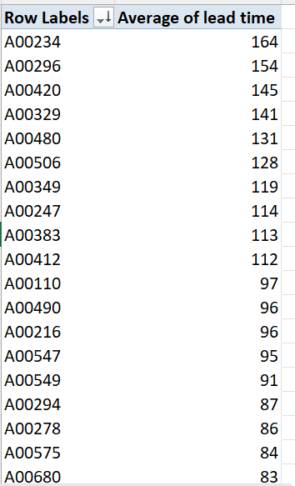
Case study 1 Average of lead time: -6276.824
For different Work orders, average of lead time is found.

Slide 3
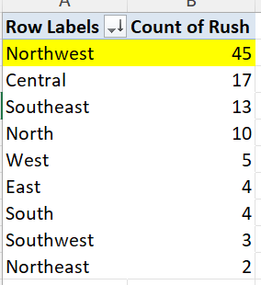
Case study 2
For different district, count of rush is shown. Northwest has the highest number of rush hours.

Slide 4
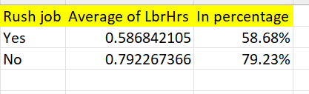
Case Study 3
Average labour hour is different for rush job and without rush job. This shown in the picture.

Slide 5
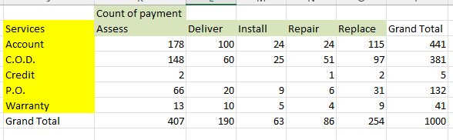
Case study 4
Distribution of different payment across services is shown.

Slide 6
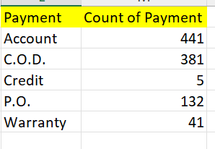
Case study 5
Trends in the distribution of payment over services shown. The trend is going downwards.

Slide 7
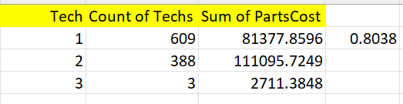
Case study 6 =CORREL(H2:H4,G2:G4)
The relation between techs and sum of parts cost is direct. If technicians increases parts costs also increases.

Slide 8
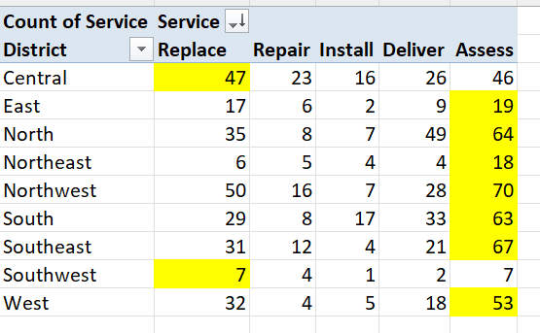
Case study 7
Most common type of services used in different district is shown.

Slide 9
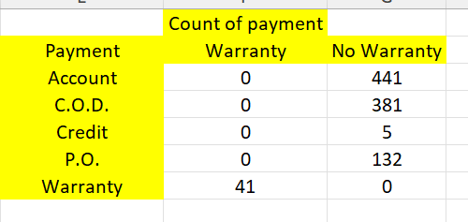
Case study 8
Distribution of payment with and without warranty hours is shown.

Slide 10
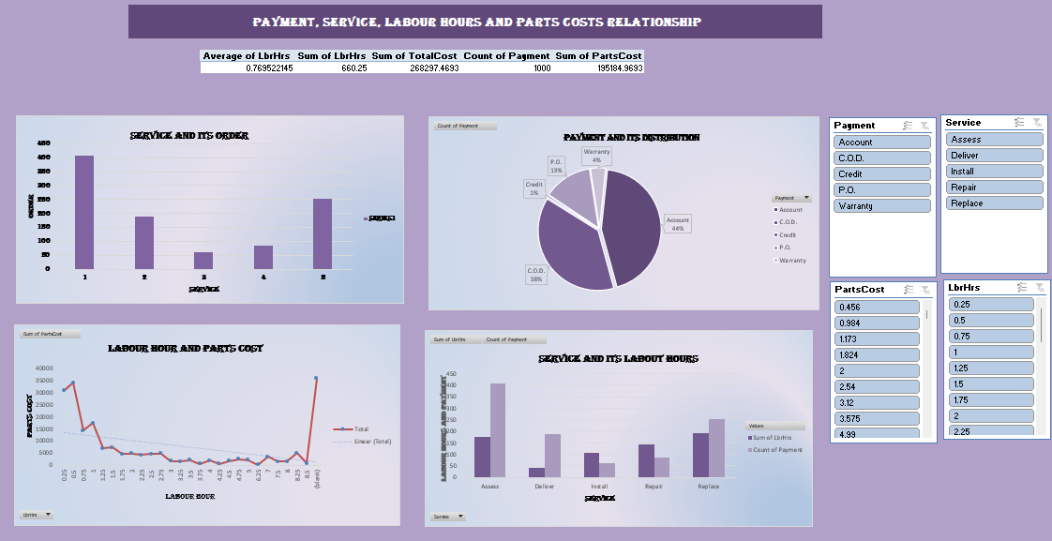
Dashboard: Here, there are four charts shown. Chart 1 is bar chart. It shows the service and its number of order placed. Chart 2 is a pie chart. It shows payment and its distribution. Chart 3 is a line chart. It shows labour hour and its profit. Chart 4 is a combo chart. It shows for particular service, what is the labour cours and payment. There are charts and slicers added.

Slide 11
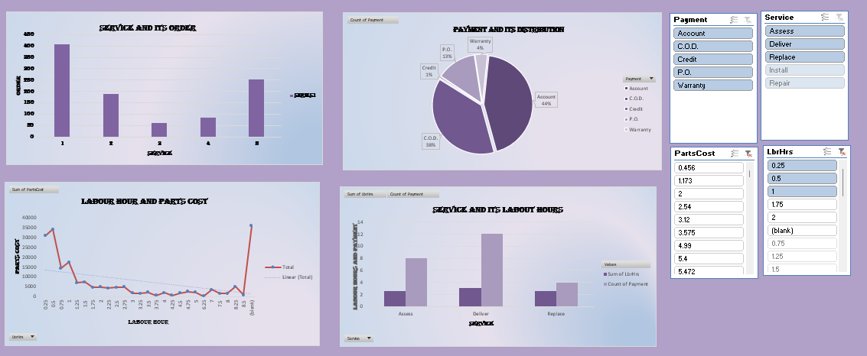
Dashboard Here, by changing slicers, the changes in the charts can be seen.

